Slide 1
BAEEE101 – BASIC ENGINEERING
Module – III – ENGINEERING GRAPHICS & CAD
Lecture – 5
Projection of Regular Solids
(Simple Position)

Slide 2
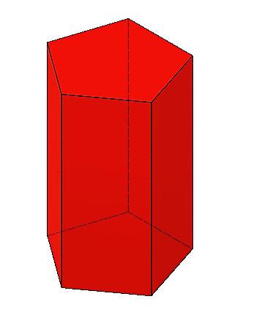
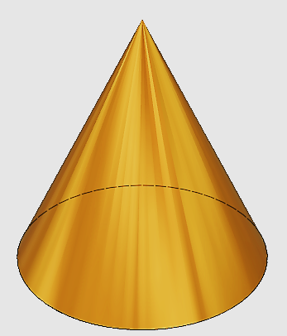
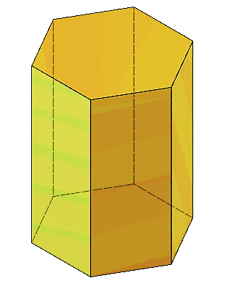
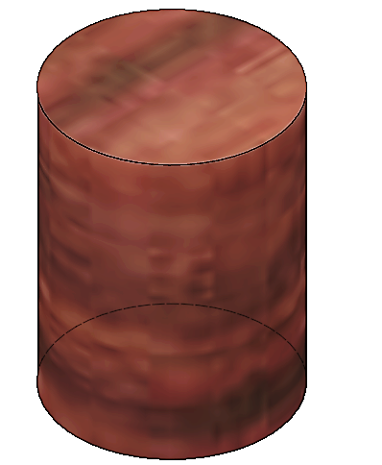
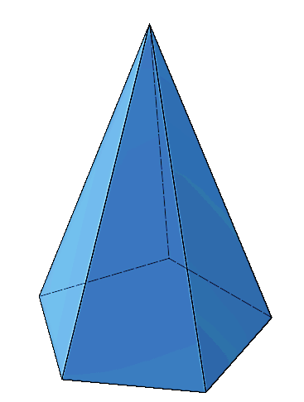
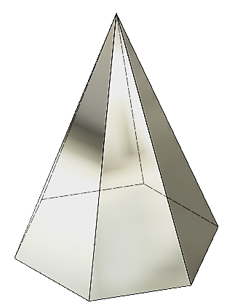
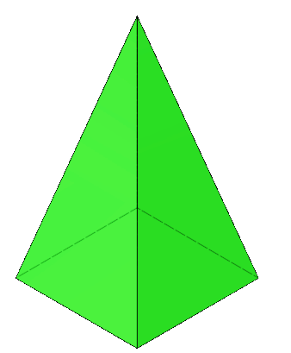

Regular Solids
Hexagonal Prism
Pentagonal Prism
Cylinder
Cone
Cube
Pentagonal Pyramid
Square Pyramid
Hexagonal Pyramid

Slide 3
Types of Solids
Solids are divided into two main groups.
Polyhedra – A solid bounded by planes called faces.
Examples: Prisms, Pyramids, Cube, Tetrahedron, octahedron etc.
Solids of Revolution – A solid generated by the revolution of rectangle or right angle triangle or semi-circle with respect to axis are known as solids of revolution. They are axisymmetric solids.
Examples: Cylinder, Cone, Sphere.

Slide 4
Importance of Regular Solids in Engineering Drawing
Regular solids are used in engineering drawing because their simple, symmetrical shapes make it easy to understand and practice drawing 3D objects accurately.
They help teach visualization, projection, and standard drawing techniques clearly and consistently.
Many complex mechanical parts and surfaces are based on or approximated using regular solids.
Using them in drawings helps:
Break down complex shapes into simpler elements
Apply geometric transformations like rotation, translation, and scaling

Slide 5
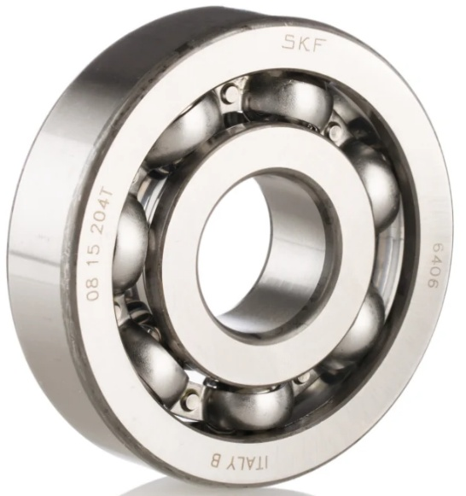
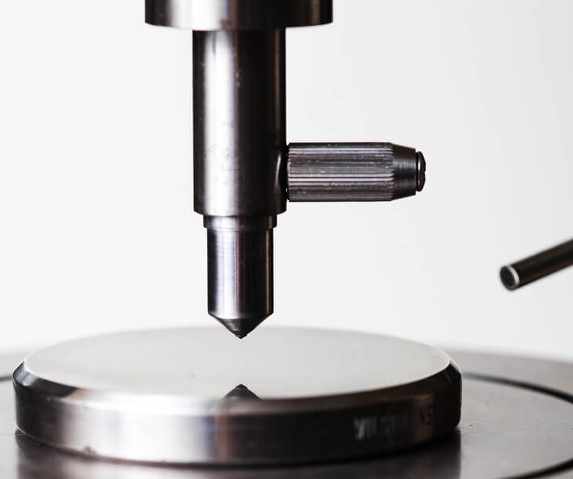
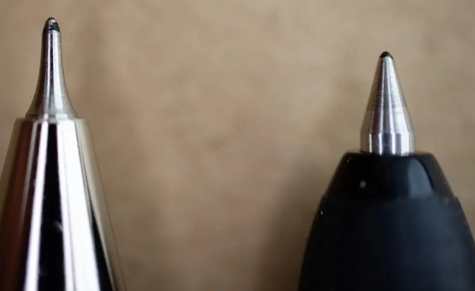
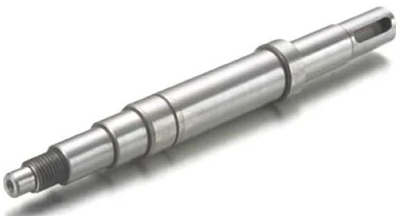
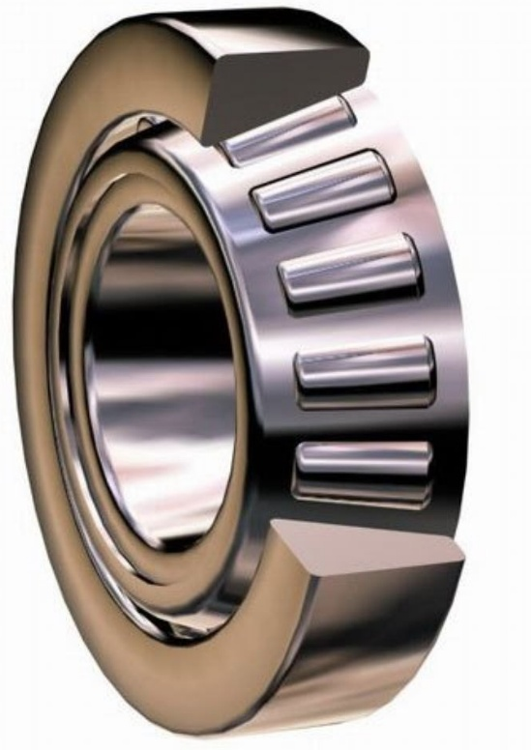
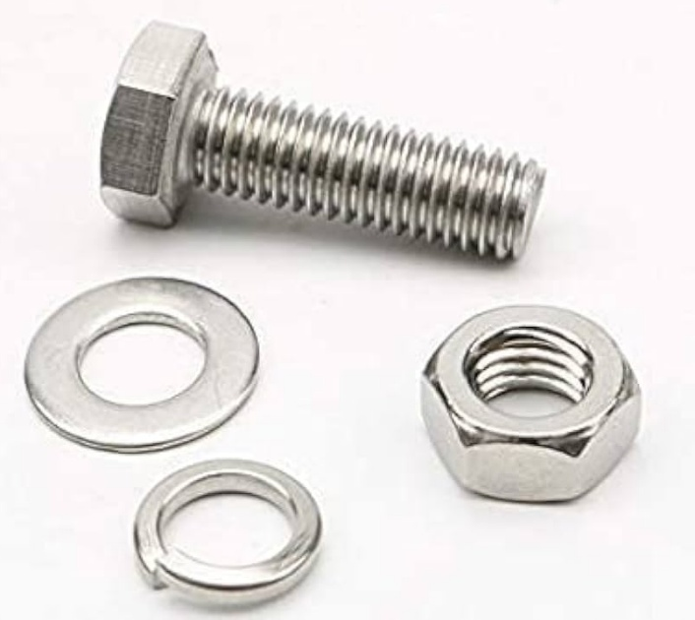
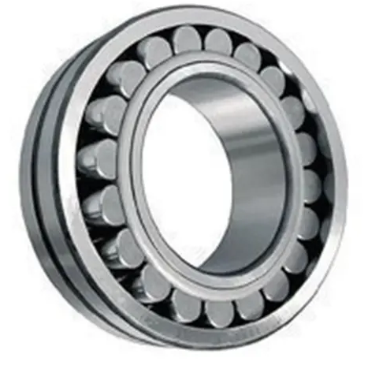
Regular Solid Approximations in real world applications

Slide 6
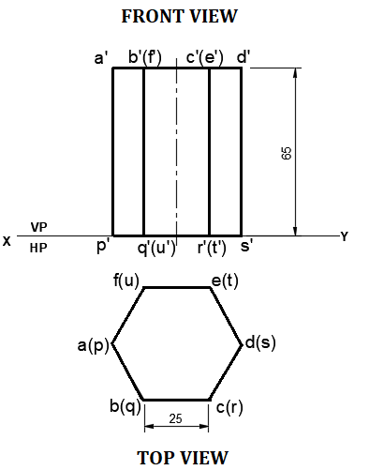
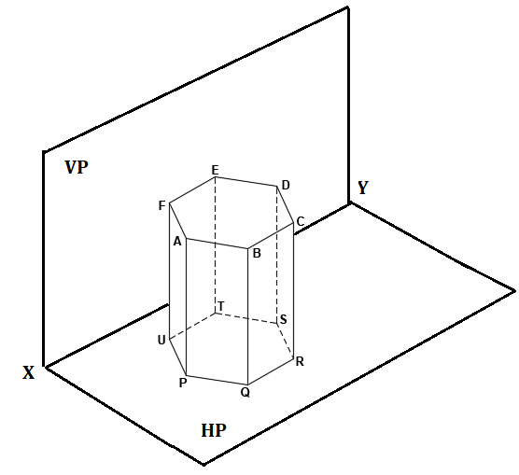
Q. A hexagonal prism of base side 25 mm and height 65 mm is resting on HP on its base with one of its base edges parallel to VP. Draw its projections.

Slide 7
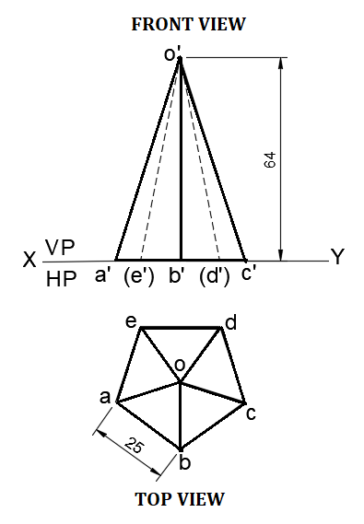
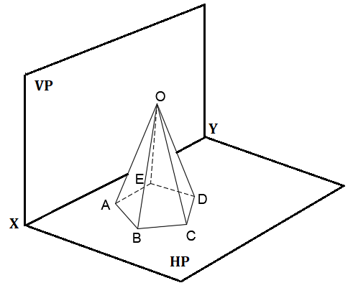
Q. A pentagonal pyramid of base side 25 mm and height 64 mm is resting on HP on its base with one of its base edges parallel to VP and nearer to it. Draw its projections.

Slide 8
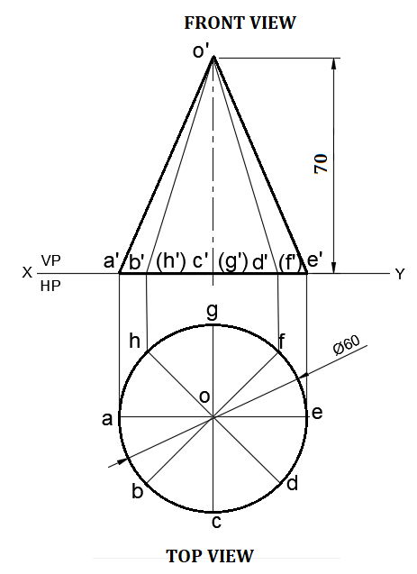
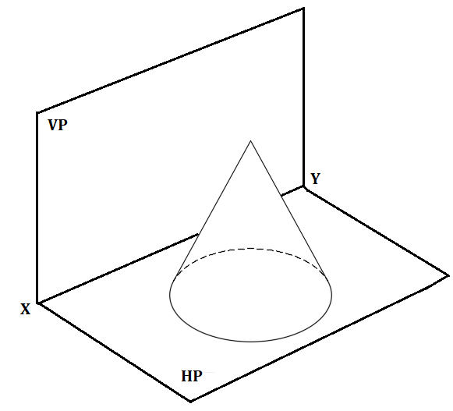
Q. A Cone of base diameter 60 mm and height 70 mm is resting on HP on its base with its axis parallel to VP and perpendicular to HP. Draw its projections.

Slide 9
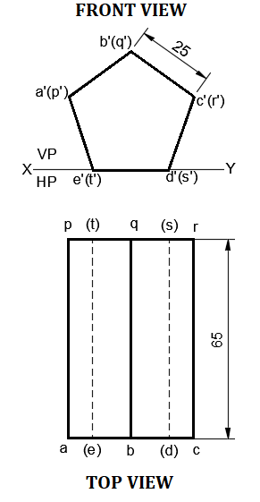
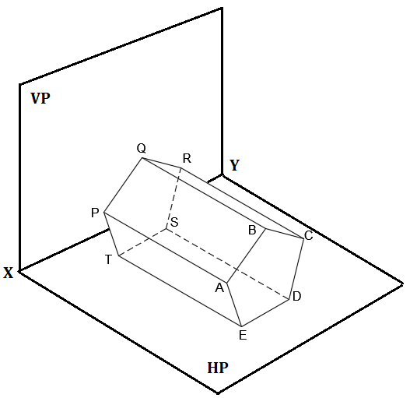
Q. A pentagonal prims of base side 25mm and height 65 mm is resting on HP on one of its rectangular faces with its axis parallel to HP and perpendicular to VP. Draw its projections.

Slide 10
Projection of Solids – Exercise Problems
Q. A hexagonal pyramid of base side 20mm and height 65 mm is resting on H.P on its base with one of its base edges 30° inclined to V.P. The axis of the pyramid is parallel to V.P and perpendicular to H.P. Draw its projections.
Q. A cylinder of diameter 65 mm and height 70 mm is resting on H.P on one of its generators with its axis parallel to H.P and perpendicular to V.P. Draw its projections.
Q. A cube of side 40 mm is resting on HP on one of its square faces in such a way that two of its vertical faces are equally inclined to VP. The vertical edge nearer to VP is at a distance of 25 mm from it. Draw its projections.
Q. A square pyramid of base side 40 mm and height 60 mm is resting on HP one its base with one of its base edges 35° inclined to VP. The base corner nearer to VP is at a distance of 20 mm from it. Draw its projections.

Slide 11
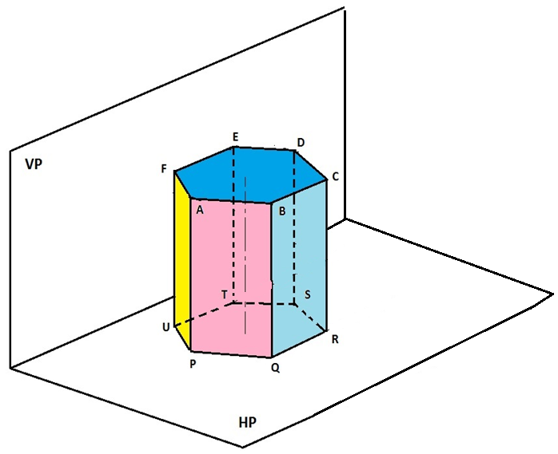
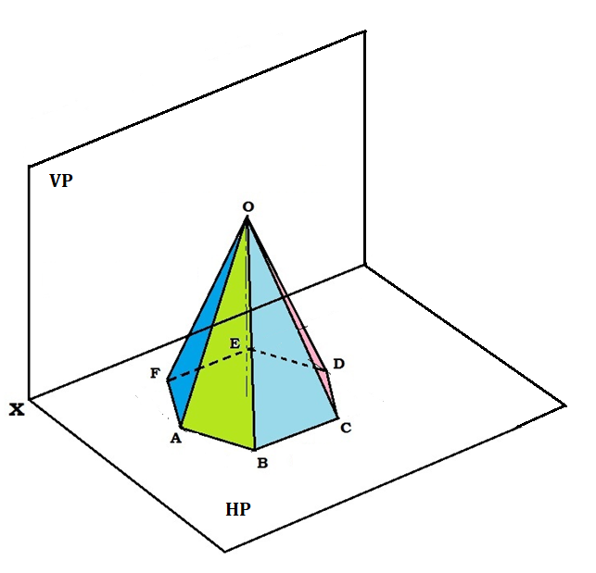
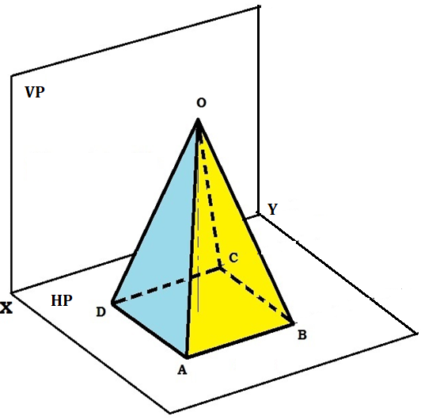
Define the position of the solids resting in first quadrant.

